Slide 1
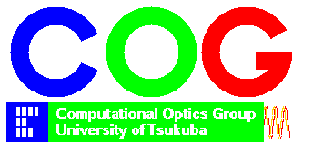
Digital refocus by depth-encoded synthetic aperture in optical coherence tomography
Lida Zhu
Computational Optics Group, University of Tsukuba

Slide 2
Introduction
OCT measurement suffers from the trade-off between lateral resolution and penetration depth.
Hardware solutions (Bessel beam) increase the complexity.
Digital refocusing does not need system modification, such as interferometric synthetic aperture (ISAM) [1], computational AO [2], sub-aperture correlation [3]. However, they requires phase stability in A-scan acquisition.
Synthetic aperture OCT is not affected by phase instability of each A-scan.
[1] Ralston T S, Marks D L, Carney P S, et al., Nature Physics, 3(2): 129-134, (2007)
[2] Shemonski N D, South F A, Liu Y Z, et al., Nature photonics, 9(7): 440-443, (2015)
[3] Kumar A, Drexler W, Leitgeb R A., Optics express, 21(9): 10850-10866, (2013)

Slide 3
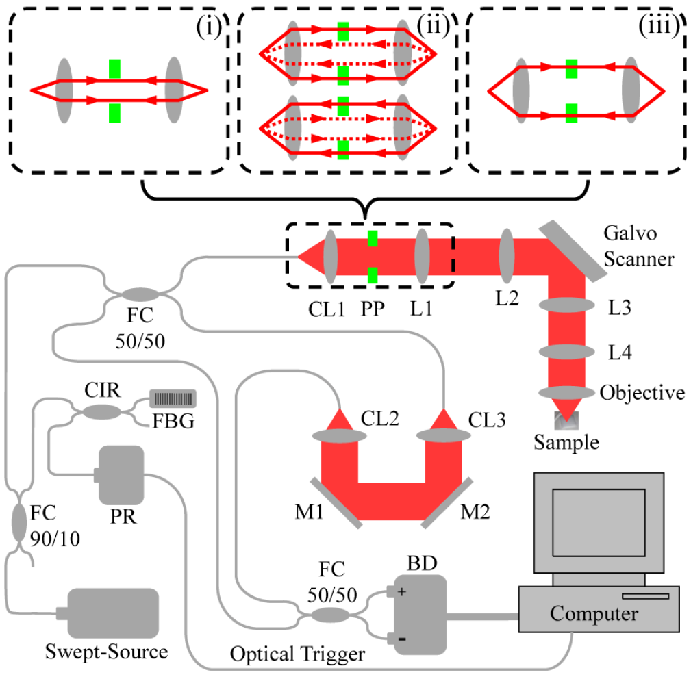
Depth-encoded synthetic aperture
PP: Annular phase plate
Portion with light retardation material
Transparent
Mo J, de Groot M, de Boer J F., Optics express, 23(4): 4935-4945, (2015)

Slide 4
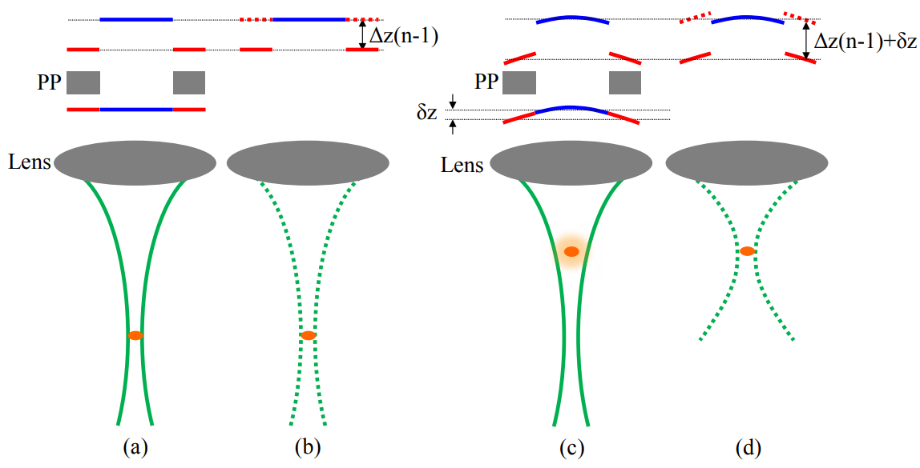
Corrected wavefront
Acquired wavefront altered by phase plate
Approximate phase difference caused by defocus
Original wavefront
In-focus
Out-of-focus
Mo, J., de Groot, M., & de Boer, J. F., Optics express, 21(8), 10048-10061, (2013).

Slide 5
Refocusing
Optimization metric:
(1) square absolute summation over certain depth range
(2) square absolute summation of each en-face image
Delay from phase plate
Local wavefront variation by defocus
Bo E, Ge X, Wang L, et al., Optics express, 26(2): 772-780, (2018)

Slide 6
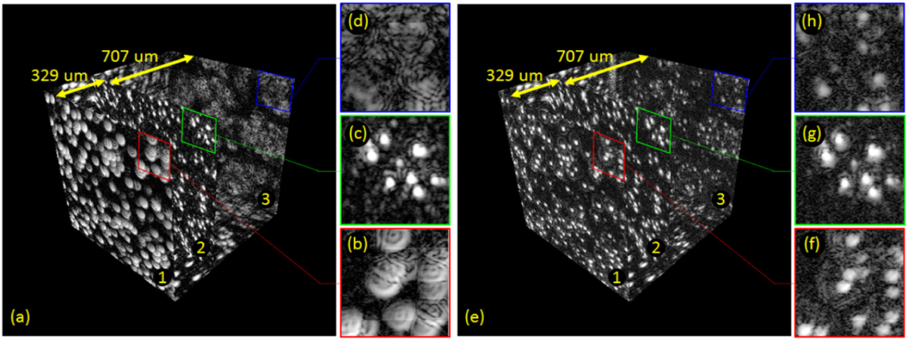
Phantom images
(Focus)

Slide 7
Depth-encoded synthetic aperture OCT:
Does not require phase stabilization at each A-scan.
OCT signal intensity could be significantly reduced by phase plate

Slide 8
Multiple aperture synthesis
MCL: microcylindrical lens
More high spatial frequency signals can be synthesized
Generate a larger aperture and an extended DOF
Sub-apertures at pupil plane
Focused beams
Bo E, Luo Y, Chen S, et al., Optica, 4(7): 701-706, (2017)

Slide 9
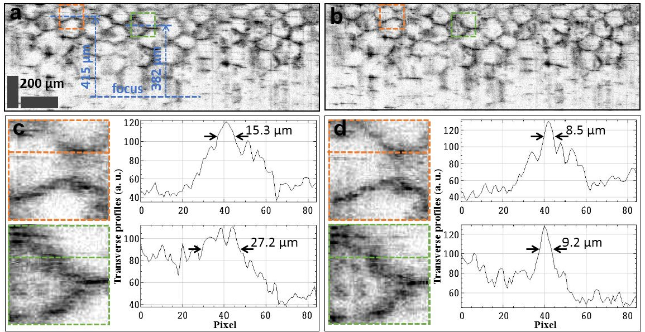
Fresh grape
Rat adipocyte
(ex vivo)
Bo, E., Ge, X., et al., Optics express, 26(2), 772-780, (2018)

Slide 10
Multiple aperture synthesis OCT:
Does not require phase stabilization at A-scans
Without signal loss due to coupling
Requires high mechanical stability of system
Limits the imaging speed

Slide 11
Parallel multiple aperture synthesis
Dielectric film (T/R 60:40)
MASE
100% reflective film
40%
36%
Bo E, Ge X, et al., Applied optics, 57(13): 3556-3560, (2018)

Slide 12
Parallel multiple aperture synthesis OCT:
Configuration is simple, easy to be implemented
Fiber-based system without mechanical set-up is stable and flexible
Signal loss of about 24%
Signal mixture of different illumination / detection apertures

Slide 13
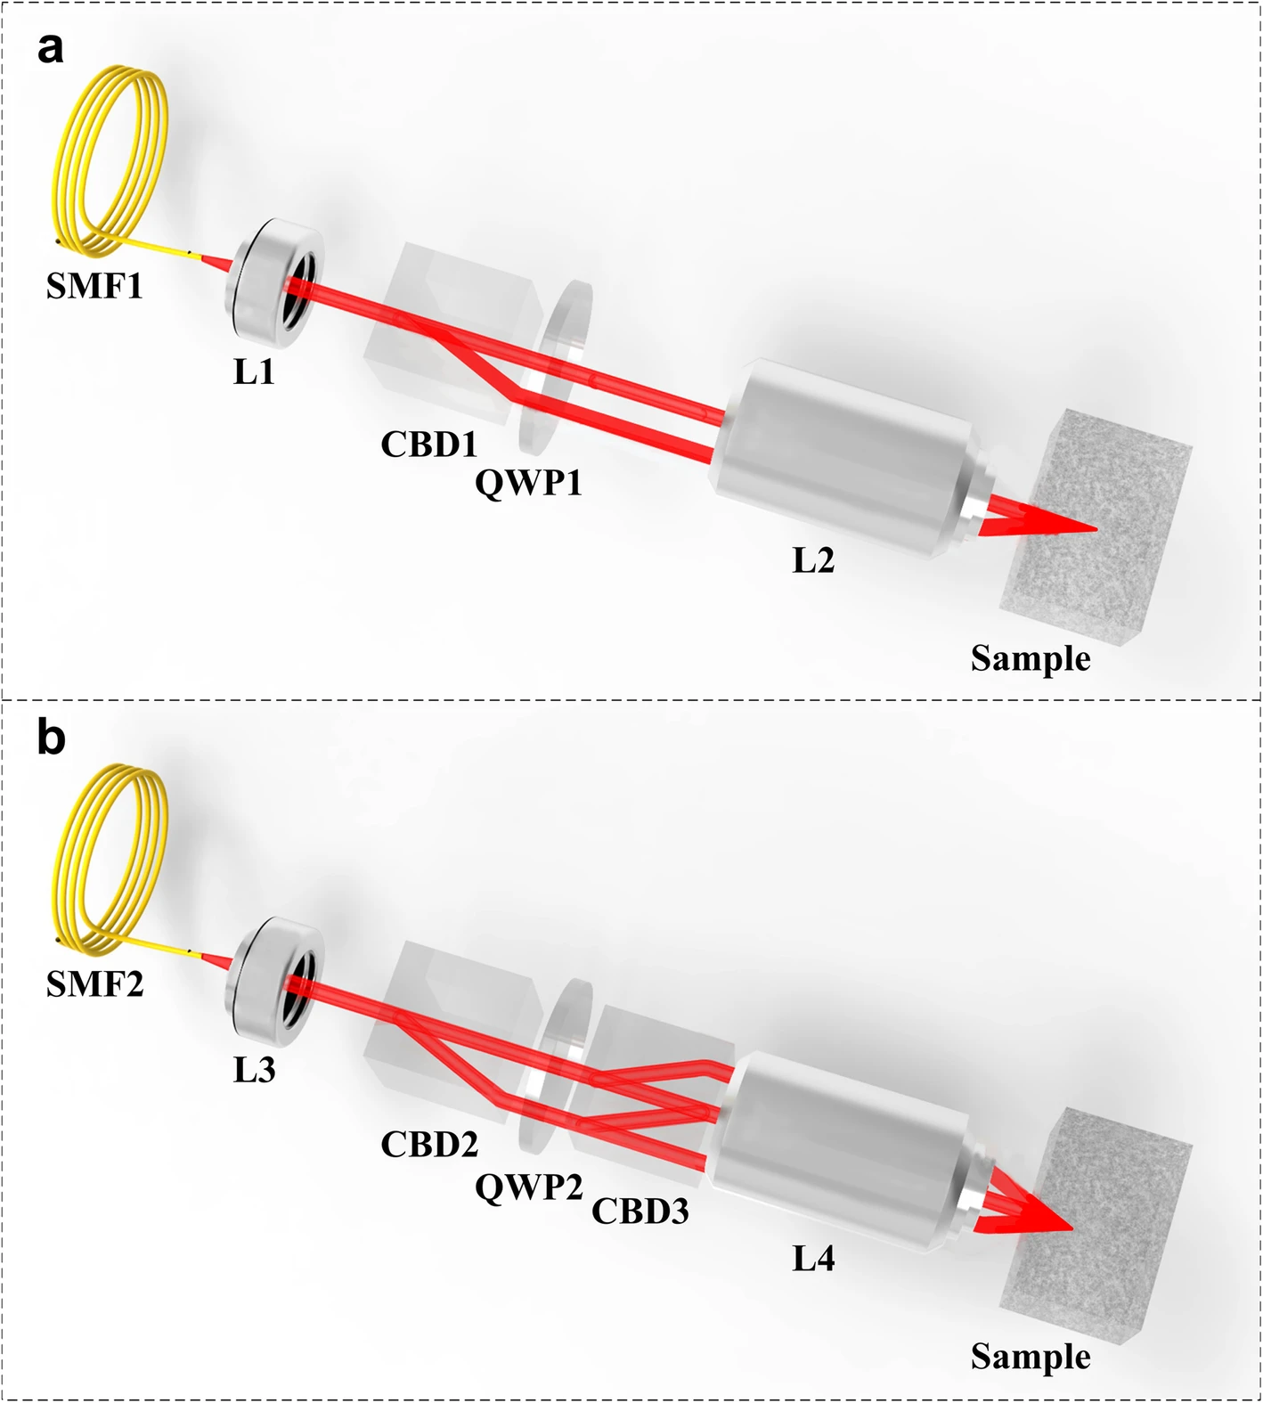
Amplitude division aperture synthesis
Bo E, Ge X, et al., PhotoniX, 1(1): 1-12, (2020)

Slide 14
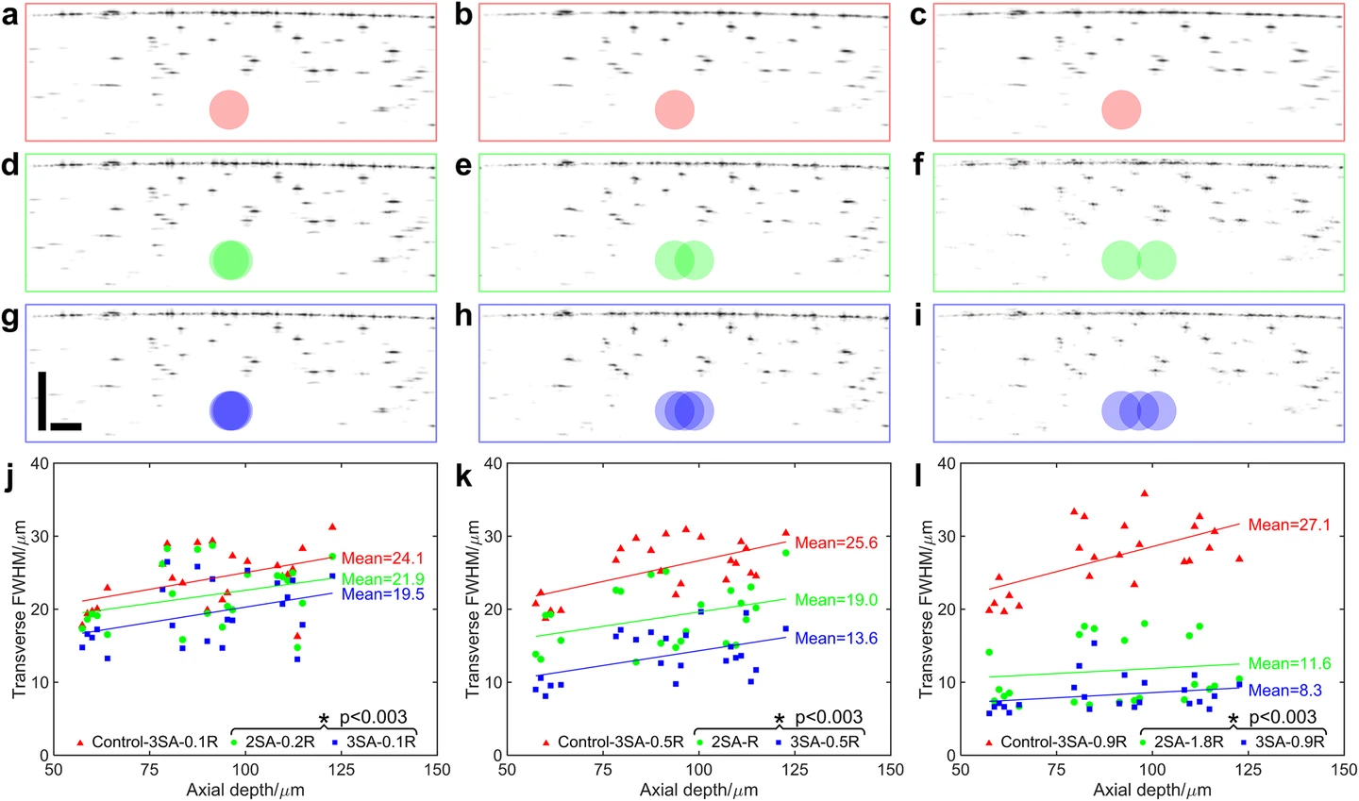
Scalable imaging performance
Adjust distance between CBD1 and CBD2
Resolution improvement
0%
Control group
9%
25%
57%
2 apertures
3 apertures

Slide 15
Amplitude division aperture synthesis OCT:
Insensitive to motion-induced phase variation
Correction performance is scalable
Imaging depth is sacrificed

Slide 16
Depth-encoded synthetic aperture OCT
No need of phase stabilization for each A-scan
*Sacrifice the imaging depth range
*Aberration cannot be precisely corrected

Slide 17
Thanks

